Slide 1
Getting What you Bargained for
Problems with “Blanket” Liens
SAMUEL I KREAMER J.D.,C.P.A.
ATTORNEY AT LAW
7155 LAKE DRIVE, SUITE 200
WEST DES MOINES, IA 50266
SIKJDCPA@
KREAMERLAW.COM

Slide 2
What’s the “problem”?
Why should you care about blanket liens?
If a customer from whom you
purchased equipment; or
accepted equipment for credit
fails to pay his creditors YOU could have liability to your customer’s creditors.
Just because you paid a customer (or provided trade-in credit) for a piece of equipment does NOT mean you now “own” it.
You may not “own” all of your “used” equipment inventory.
You can be dead without knowing you are sick.

Slide 3
How does this happen?
Simply stated: your customer’s equipment could be covered by a “blanket lien” which gives the customer’s lender certain rights to the customer’s pursuant to the Uniform Commercial Code.

Slide 4
OVERVIEW
Uniform Commercial Code (the “UCC”)
Adopted to govern commercial transactions, BOTH between merchants and customers as well as lenders and borrowers.
All 50 states have adopted the UCC
There may be some variances among states
Iowa and Nebraska UCC versions are substantially the same
Article 9 of the UCC Regulates rights to property used as loan collateral in the event of a loan default

Slide 5
Terms
Key Terms
Security Interest
Collateral
Perfection
Priority
Documents

Slide 6
Terms
Security Interest/Collateral
Security Interest
Purchase Money Security Interest
Blanket Lien
Collateral
Words Matter
Application

Slide 7
Terms
Allocation of Security Interest
Purchase Money- All to One
Blanket Lien- All to All
 |  | Percentage | Secured | IF Allocated
Tractor | Value | of Value | Amount | Amount
A | 15,000 | 12.50% | 90,000 | 11,250
B | 45,000 | 37.50% | 90,000 | 33,750
C | 60,000 | 50.00% | 90,000 | 45,000
 | 120,000 |  |  | 90,000
 | THE ALLOCATED AMOUNT IS NOT USED. ALL TRACTORS ARE SUBJECT
 | TO SECURITY INTEREST UNTIL AMOUNT IS FULLY PAID .

Slide 8
Terms
Perfection/Priority
For Today’s Presentation PERFECTION is NOT:

Slide 9
TERMS
Perfection/Priority
Nor is it:

Slide 10
Terms
Perfection/Priority
Perfection: Compliance with necessary procedures
Priority: The order in which creditors have rights to collateral
Notice
Constructive Notice
Actual Notice

Slide 11
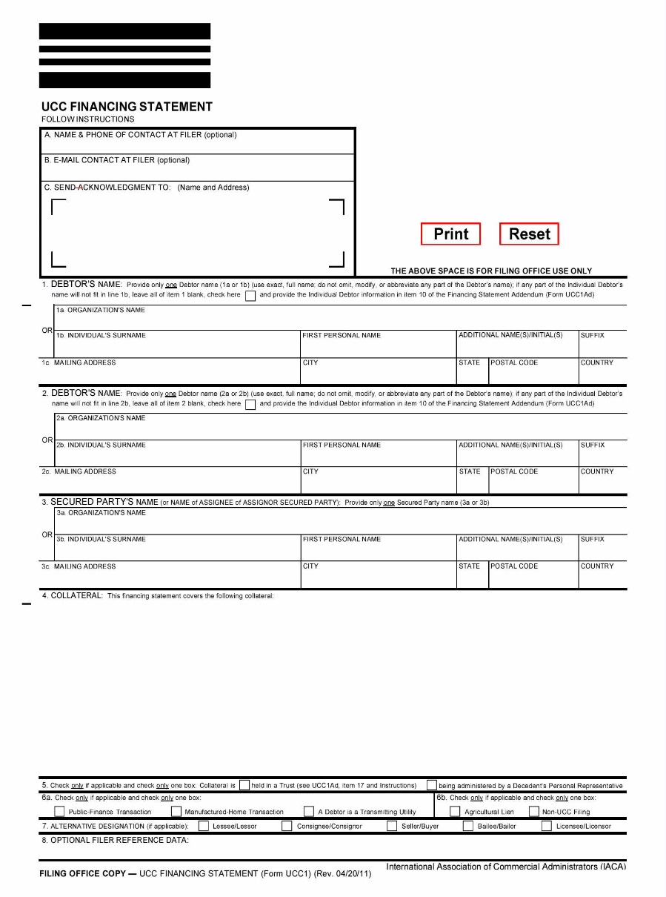
UCC Forms
UCC-1 To Establish the Lien

Slide 12
UCC Forms
UCC-3 to Amend the Lien

Slide 13
Secured Transactions
Basic Concepts
Purchase Money Security Interest takes priority over ALL Blanket liens
Security interest follows BOTH:
Collateral
Proceeds from sale of collateral
Creditor only get paid ONCE

Slide 14
Facts
These will be used for all examples
Farmer F owns Tractor A valued at $20k
Farmer F has an operating line with Bank X with a balance of $75k
The line is secured by a blanket lien on several items including “All machinery and equipment used in farming operations”

Slide 15
Farmer F Defaults
At time of Default, other assets of Farmer F subject to (covered by) blanket lien equal $20k
Bank X acquires and sells other assets for $20k
Net due to Bank X by Farmer F on blanket lien is $55k ($75 indebtedness - $20k other assets)

Slide 16
General Rule
No Resale or Trade
Process:
Bank X acquires $20k sales proceeds from Tractor A from Farmer F
Bank X acquires Tractor A from Dealer, and sells at auction
Bank X gets proceeds of auction up to remaining amount due from Farmer F.
Dealer receives any excess

Slide 17
Example 1
No Resale or Trade/Farmer Retains Cash
Prior to Default, Dealer buys Tractor A for $20k (cash). Farmer F defaults on line.
Process:
Bank X acquires $20k sales proceeds from Tractor A from Farmer F
Bank X acquires Tractor A from Dealer, and sells at auction
Bank X gets proceeds of auction up to remaining amount due from Farmer F.
Dealer receives any excess
Bank X recovers $20k in proceeds from Farmer F’s sale of Tractor A
Farmer F’s debt to Bank X: $35k [$55-20k]
Bank X acquires Tractor A from Dealer and auctions for $25k.
Bank X acquires all proceeds from auction (remaining debt is $10k)
Dealer’s net loss is $20k (purchase price of Tractor A)

Slide 18
Example 2
No Resale or Trade/Farmer Spends Cash
Prior to Default, Dealer buys Tractor A for $20k (cash). Farmer F defaults on line; Farmer F spends cash
Process:
Bank X acquires $20k sales proceeds from Tractor A from Farmer F
Bank X acquires Tractor A from Dealer, and sells at auction
Bank X gets proceeds of auction up to remaining amount due from Farmer F.
Dealer receives any excess
Bank X recovers $0 in proceeds from Farmer F
Farmer F’s debt to Bank X: $55k
Bank X acquires Tractor A from Dealer and auctions for $25k.
Bank X acquires all proceeds from auction (remaining debt is $30k)
Dealer’s net loss is $20k (purchase price of Tractor A)

Slide 19
Example 3
No Resale or Trade/Farmer Keeps Cash/Excess Proceeds
Bank X recovers more at auction than the amount owed from Farmer F
Process:
Bank X acquires $20k sales proceeds from Tractor A from Farmer F
Bank X acquires Tractor A from Dealer, and sells at auction
Bank X gets proceeds of auction up to remaining amount due from Farmer F.
Dealer receives any excess
Bank X recovers $20 in proceeds from Farmer F
Farmer F’s debt to Bank X: $35k ($55-20k)
Bank X acquires Tractor A from Dealer and auctions for $40k.
Bank X acquires all proceeds from auction up to $35k
Dealer gets $5k
Dealer’s net loss is $15k (purchase price of Tractor A - $5k proceeds from auction)

Slide 20
Example 4
No Resale or Trade/Dealer Takes Out Loan/Farmer Keeps Cash
Dealer takes out a $20k loan from Bank Y to purchase Tractor A. Bank Y (Dealer’s lender) secures loan with Tractor A
Process:
Bank X acquires $20k sales proceeds from Tractor A from Farmer F
Bank X acquires Tractor A from Dealer, and sells at auction
Bank Y collects up to outstanding value of loan on sale of Tractor A. Remainder goes to Bank X to satisfy Bank X credit
Excess on sale of Tractor A to Dealer
Dealer responsible for remainder of loan to Bank Y
Bank X recovers $20k in proceeds from Farmer F’s sale of Tractor A
Farmer F’s debt to Bank X: $35k ($55-20k)
Dealer’s debt to Bank Y: $20k
Bank X acquires Tractor A from Dealer and auctions for $25k.
Bank Y (Dealer’s lender) has superpriority on Tractor A, recovers $20k (Dealer loan)
$5k (remainder from auction) to Bank X (Farmer F’s lender)
Dealer has no net loss

Slide 21
Example 4
Note
Same result if Dealer provides financing and takes security interest on Tractor A

Slide 22
Example 5
No Resale or Trade/Dealer Takes Out Loan/Farmer Keeps Cash/Unsuccessful Auction
Dealer takes out a $20k loan from Bank Y to purchase Tractor A. Bank Y (Dealer’s lender) secures loan with Tractor A. Auction yields $10k.
Process:
Bank X acquires $20k sales proceeds from Tractor A from Farmer F
Bank X acquires Tractor A from Dealer, and sells at auction
Bank Y collects up to outstanding value of loan on sale of Tractor A. Remainder goes to Bank X to satisfy Bank X credit
Excess on sale of Tractor A to Dealer
Dealer responsible for remainder of loan to Bank Y
Bank X recovers $20k in proceeds from Farmer F’s sale of Tractor A
Farmer F’s debt to Bank X: $35k ($55-20k)
Dealer’s debt to Bank Y: $20k
Bank X acquires Tractor A from Dealer and auctions for $10k.
Bank Y (Dealer’s lender) has superpriority on Tractor A, recovers $10k (Dealer loan)
Dealer’s debt to Bank Y: $10k ($20 Bank Y loan -10k auction proceeds)
Dealer still responsible for remaining $10k on Bank Y loan

Slide 23
General Rule
With Resale
Process:
Bank X acquires $20k sales proceeds from Tractor A from Farmer F
Bank X acquires Tractor A from Farmer G, and sells at auction
Bank X gets proceeds of auction up to remaining amount due from Farmer F.
Farmer G receives any excess
Farmer G can sue Dealer for the difference between the value of Tractor A (when repossessed by Bank X) and refund received by Farmer G from auction

Slide 24
Example 6
With Resale
Dealer buys Tractor A from Farmer F for $20k (cash). Dealer then sells Tractor A to Farmer G for $25k (cash)
Process:
Bank X acquires $20k sales proceeds from Tractor A from Farmer F
Bank X acquires Tractor A from Farmer G, and sells Tractor A at auction
Bank X collects up to outstanding value of loan on sale of Tractor A. Remainder goes to Farmer G
Farmer G can sue Dealer for the difference between the value of Tractor A (when repossessed by Bank X) and refund received by Farmer G from auction (if any)
Bank X recovers $20k in proceeds from Farmer F’s sale of Tractor A
Farmer F’s debt to Bank X: $35k ($55-20k)
Bank X acquires Tractor A from Farmer G and auctions for $10k.
Farmer F’s debt to Bank X is $25k ($35-10k)
No excess at auction, no refund to Farmer G
Farmer G sues Dealer
Dealer is liable for value of Tractor A (at time of repossession by Bank X-assumed $25k) – refund ($0)
Dealer’s net loss $25k

Slide 25
General Rule
With Trade/No Resale
Process:
Bank X acquires proceeds of collateral up to outstanding value of loan
Bank X acquires Tractor A from Dealer, and sells Tractor A at auction
Dealer gets any amount received by Bank X over outstanding debt.

Slide 26
Example 7
With Trade/No Resale
Farmer F trades Tractor A for a $15k credit applied to Tractor B from Dealer with a total value of $50k; and Farmer F pays remaining $35k in cash
Process:
Bank X acquires Tractor B from Farmer F, and sells Tractor B at auction
Bank X acquires Tractor A from Dealer, and sells Tractor A at auction
Bank X collects up to outstanding value of loan on sale of Tractor A. Remainder goes to Dealer
Bank X recovers Tractor B as proceeds from Farmer F’s sale of Tractor A
Bank X auctions Tractor B for $40k
Farmer F’s debt to Bank X: $15k ($55-40k)
Bank X acquires Tractor A from Dealer and auctions for $10k.
Bank X acquires all proceeds from auction (remaining debt is $5k)
Dealer’s net loss is $15k (value of Tractor A in trade of Tractor B)

Slide 27
Example 7
Note
The credit for the trade-in does not qualify for superpriority because it is not a “loan” to Farmer F, but rather a substitution of Tractor A for part of the purchase price of Tractor B

Slide 28
Example 8
With Trade/No Resale/Farmer F Takes Out a Loan to Buy Tractor B
Farmer F (subject to a blanket lien held by Bank X) trades Tractor A for a $15k credit applied to Tractor B from Dealer with a total value of $50k; and Farmer F pays remaining $35k through loan from Bank Y (non-holder of blanket lien) for which Tractor B is collateral
Process:
Bank Y has superpriority on Tractor B
Bank X acquires Tractor B from Farmer F, and sells at auction
Bank X acquires Tractor A from Dealer, and sells at auction
Dealer gets any amount received by Bank X over outstanding debt.
Bank X recovers Tractor B from Farmer F as proceeds from Farmer F’s trade of Tractor A
Bank X auctions Tractor B for $40k
Bank Y takes first on Tractor B
Satisfies $35k loan from Bank Y
$5k remainder to Bank X
Farmer F’s debt to Bank X $50k ($55k remaining debt - $5k)
Bank X acquires Tractor A from Dealer and auctions for $10k.
Bank X acquires all proceeds from auction
Dealer’s net loss is $15k (value of Tractor A received in trade for Tractor B)

Slide 29
General Rule
With Trade, Resale, and Financing
Process:
Bank X acquires proceeds of collateral up to outstanding value of loan; proceeds include Tractor B
Bank Y has superpriority on proceeds from Tractor B at auction
Bank X acquires Tractor A from Farmer G, and sells at auction
Farmer G gets any amount received for Tractor A by Bank X over outstanding debt.
Farmer G can sue Dealer for the difference between the value of Tractor A (at time of Bank X repossession) and refund from auction

Slide 30
Example 9
With Trade/Resale/Farmer F Takes Out a Loan to Buy Tractor B
Farmer F trades Tractor A for a $15k credit applied to Tractor B from Dealer with a total value of $50k; and
Farmer F pays remaining $35k through loan from Bank Y naming Tractor B as collateral; and
Dealer sells Tractor A to Farmer G for $25k
Process:
Bank X acquires proceeds of collateral up to outstanding value of loan; proceeds include Tractor B
Bank Y has superpriority on proceeds from Tractor B at auction
Bank X acquires Tractor A from Farmer G, and sells at auction
Farmer G gets any amount received for Tractor A by Bank X over outstanding debt.
Farmer G can sue Dealer for the difference between the value of Tractor A (at time of Bank X repossession) and refund from auction
Bank X recovers Tractor B as proceeds from Farmer F’s sale of Tractor A
Tractor B auctions for $40k
Bank Y takes first on Tractor B
Satisfies $35k loan
$5k remainder to Bank X for Farmer F’s loan
Farmer F’s debt to Bank X: $50k ($55-5k)
Bank X acquires Tractor A from Farmer G and auctions for $10k.
Farmer F’s debt to Bank X is $25k ($35-10k)
No excess at auction, no refund to Farmer G
Farmer G sues Dealer
Dealer is liable for value of Tractor A (at time of Bank X’s repossession, assumed $20k) – refund to Farmer G from auction
Dealer’s net loss $10k ($20k value - $10k profit from credit to sale to Farmer G)

Slide 31
WHAT THE [EXPLITIVE] SHOULD YOU DO???
Ronald Regan Rule
Contact the lender, and have them issue, and file, a UCC-3 to delete the item from the description of collateral
Try filing a UCC-5 Information statement
PRAY!!

